Slide 1
Micro-Credit Defaulter Model

Slide 2
A Microfinance Institution (MFI)
A Microfinance Institution (MFI) is an organization that offers financial services to low income populations
The Microfinance services (MFS) provided by MFI are Group Loans, Agricultural Loans, Individual Business Loans and so on.
MFS becomes very useful when targeting especially the unbanked poor families living in remote areas with not much sources of income

Slide 3
Exercise
Build a model which can be used to predict in terms of a probability for each loan transaction, whether the customer will be paying back the loaned amount within 5 days of insurance of loan

Slide 4
Loading data
We have loaded the data from the CSV file ,now are going to Analyse the data

Slide 5
Data columns
Range Index: 209593 entries, 0 to 209592 Data columns (total 37 columns):
We are going to analyse the data columns and row

Slide 6
pandas.DataFrame.describe
df.describe(include='all') categorical numeric object
The percentiles to include in the output. All should fall between 0 and 1. The default is [.25, .5, .75], which returns the 25th, 50th, and 75th percentiles.
The describe function which has the count,mean,std,min,max

Slide 7
Data exploration
univariate analysis
Bivariate analysis
Univariate Analysis which is used for analysis of single variable
Bivariate Analysis which is used for analysis the multi variable

Slide 8
univariate analysis
Categorical variable
Count%, count
Bar-chart, pie chart
Numerical variable
Max,min,mean,median,mode
Kurtosis, skewness
Variance ,std dev,quartiles,range,co-efficient of variation
Box plot, histogram

Slide 9
Bivariate analysis
Categorical variable &
Categorical variable
Numerical variable ​&
Numerical variable
Numerical variable &
Categorical variable
Chi square test
2-y axis plot,
bar chart
Scatter plot
correlation
T test,z-test
Anova
2-y axis plot,bar &line charts

Slide 10
unique & columns groups
Unique are returned in order of appearance
Columns groups which is used for divided into dtypes,int ,float, object

Slide 11
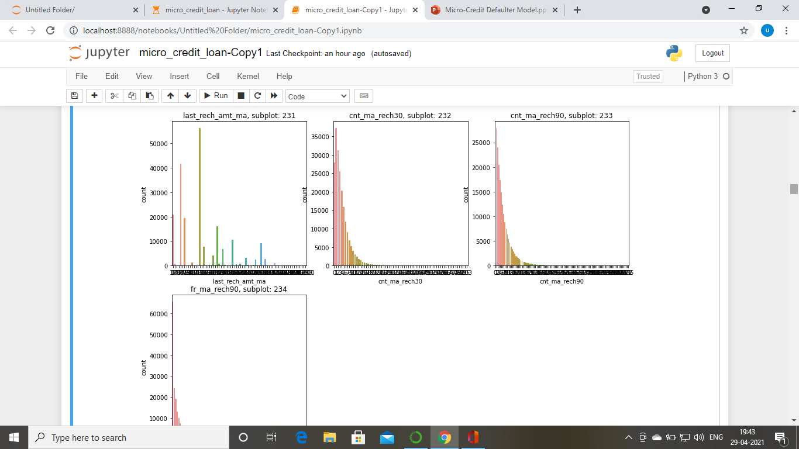
Univariate Analysis

Slide 12
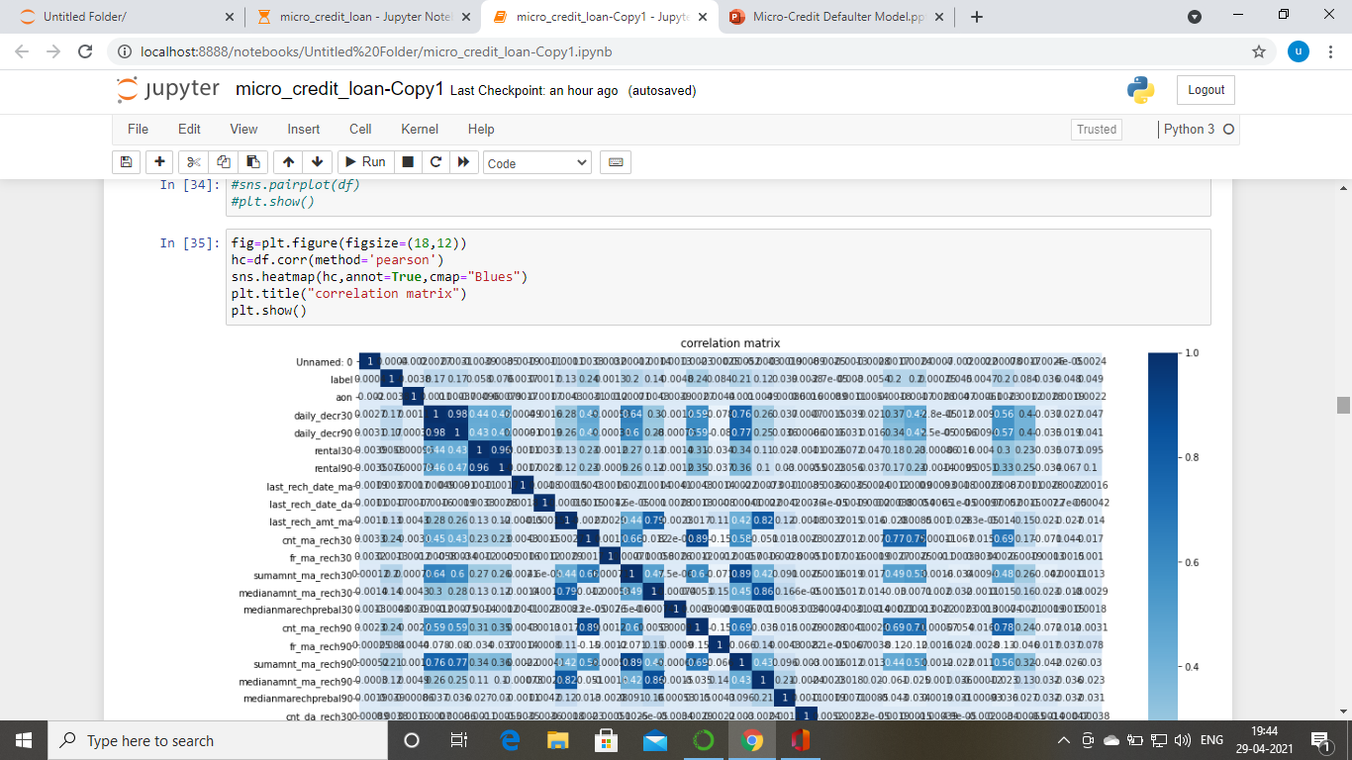
Bi-variate Analysis

Slide 13
Data pre processing
We have null function check the value
By using heat map we found the null value present

Slide 14
Label Encoder
Encode target labels with value between 0 and n_classes-1.
This transformer should be used to encode target values
Label encoder which is used convert the categorical value into numerical value

Slide 15
Outliers
from SciPy import stats
Compute the z score of each value in the sample, relative to the sample mean and standard deviation.

Slide 16
Skewness & Power transform
Skewness is a measure of the asymmetry of the probability distribution of a real-valued random variable about its mean
Power transform
Apply a power transform feature wise to make data more Gaussian-like.Box-Cox requires input data to be strictly positive, while Yeo-Johnson supports both positive or negative data.

Slide 17
StandardScaler
The standard score of a sample x is calculated as:
z = (x - u) / s
where u is the mean of the training samples or zero if with_mean=False, and s is the standard deviation of the training samples or one if with_std=False.

Slide 18
Models & Cross val score
Logistic Regression
0.8773587156182161
DecisionTreeClassifier
0.8813903003411341
RandomForestClassifier
0.9211574703595029
AdaBoostClassifier
0.9114005582194231
Cross val score for Logistic Regression
0.8763603741131372
Cross val scocre for DecisionTreeClassifier
0.8834026026403567
Cross val score for RandomForestClassifier
0.9208943104702204
Cross val score for AdaBoostClassifier
0.9112995202176852

Slide 19
GridSearchCV
Exhaustive search over specified parameter values for an estimator.
Important members are fit, predict.
GridSearchCV implements a “fit” and a “score” method. It also implements “score_samples”, “predict”, “predict_proba”, “decision_function”, “transform” and “inverse_transform” if they are implemented in the estimator used.

Slide 20
Receiver Operating Characteristic (ROC)
ROC curves typically feature true positive rate on the Y axis, and false positive rate on the X axis. This means that the top left corner of the plot is the “ideal” point - a false positive rate of zero, and a true positive rate of one. This is not very realistic, but it does mean that a larger area under the curve (AUC) is usually better.
The “steepness” of ROC curves is also important, since it is ideal to maximize the true positive rate while minimizing the false positive rate.

Slide 21
conclusion
Joblib is a set of tools to provide lightweight pipelining in Python. In particular, joblib offers: transparent disk-caching of the output values and lazy re-evaluation (memoize pattern)
RandomForestClassifier
0.9211574703595029 is successful model
import joblib
joblib.dump(GCV.best_estimator_,"microcredictloanDTC.pkl")

